Slide 1
DATA ANALYTICS PROJECT
Improving Student Academic Performance Through Data Analytics
Identifying the Key Drivers of Student Success
Rafiu Hammed Abiola
Mentor: Yusuf Godwin • Group: c3 adv. Data analysis & visualization 002
Deep_Tech/WESOnline Mentorship Program End-of-Cohort Project Presentation

Slide 2
Problem Statement
02
Turning student records into decisions remains a challenge.
01
02
03
Data overload
Hidden patterns
Targeted support
Schools collect student records
but may struggle to convert them into actionable insights.
Performance differences and student groups can be difficult to identify from raw
records.
Without evidence, interventions may be
broad rather than focused.
Project response
Build a repeatable analytics workflow that turns raw student data into clear evidence for academic decisions.
Student Academic Performance Analytics | Deep_Tech/WESOnline

Slide 3
Project Overview / Solution
03
From raw records to actionable educational insight.
DATA
ANALYZE
VISUALIZE
DECIDE
Clean & prepare
→
Explore patterns
→
Build dashboard
→
Act on evidence
Power Query / Python
Python / SQL
Power BI
Educators / schools
Core output
An interactive Power BI dashboard for KPIs, performance distribution, subject analysis, and attendance relationships.
Student Academic Performance Analytics | Deep_Tech/WESOnline

Slide 4
Tools & Technologies
04
Python
SQL
Excel
PY
SQL
XL
Pandas • EDA
Queries • Analysis
Preparation
Power Query
Power BI
GitHub
PQ
BI
GH
Cleaning • Transform
Dashboard • DAX
Documentation
Student Academic Performance Analytics | Deep_Tech/WESOnline

Slide 5
Methodology / Implementation
05
Seven stages from business question to decision-ready insight.
01
02
03
04
05
06
07
›
›
›
›
›
›
Business Understanding
Data Understanding
Cleaning & Quality
EDA
KPI Definition
Power BI Dashboard
Insights & Recommenda-
tions
Quality principle
Each stage was documented so the analysis can be reproduced, reviewed, and extended.
Student Academic Performance Analytics | Deep_Tech/WESOnline

Slide 6
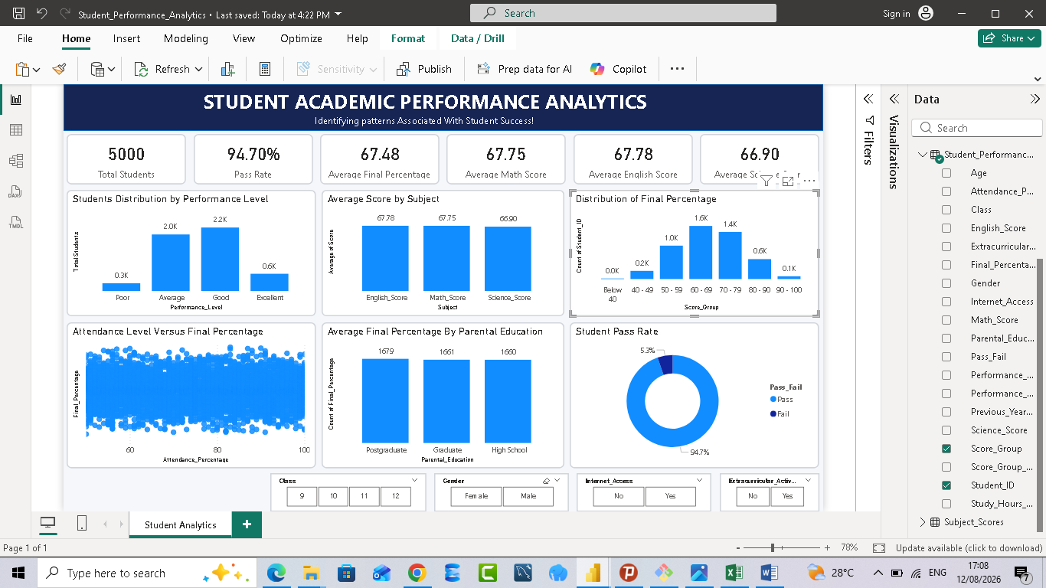
Results / Demo
06
POWER BI DASHBOARD
5,000
Students
94.70%
Pass Rate
67.48
Average Final %
60.70% scored within the 60–79%
final-percentage range.
Student Academic Performance Analytics | Deep_Tech/WESOnline

Slide 7
Conclusion, Recommendations & Future Improvements
07
KEY TAKEAWAYS
RECOMMENDATIONS
FUTURE IMPROVEMENTS
94.70% pass rate
Target lower-performing students
Add teacher and school factors
67.48% average final percentage
Support middle-performing students
Include engagement/context
variables
60.70% scored 60–79%
Use multiple indicators
Develop predictive analytics
No single strong linear driver
identified
Collect richer educational data
Expand to additional schools
Analytics should support—not replace—professional educational judgment.
Student Academic Performance Analytics | Deep_Tech/WESOnline

